Slide 1
Deforestation and its impact on the environment
By Christopher Barreto

Slide 2
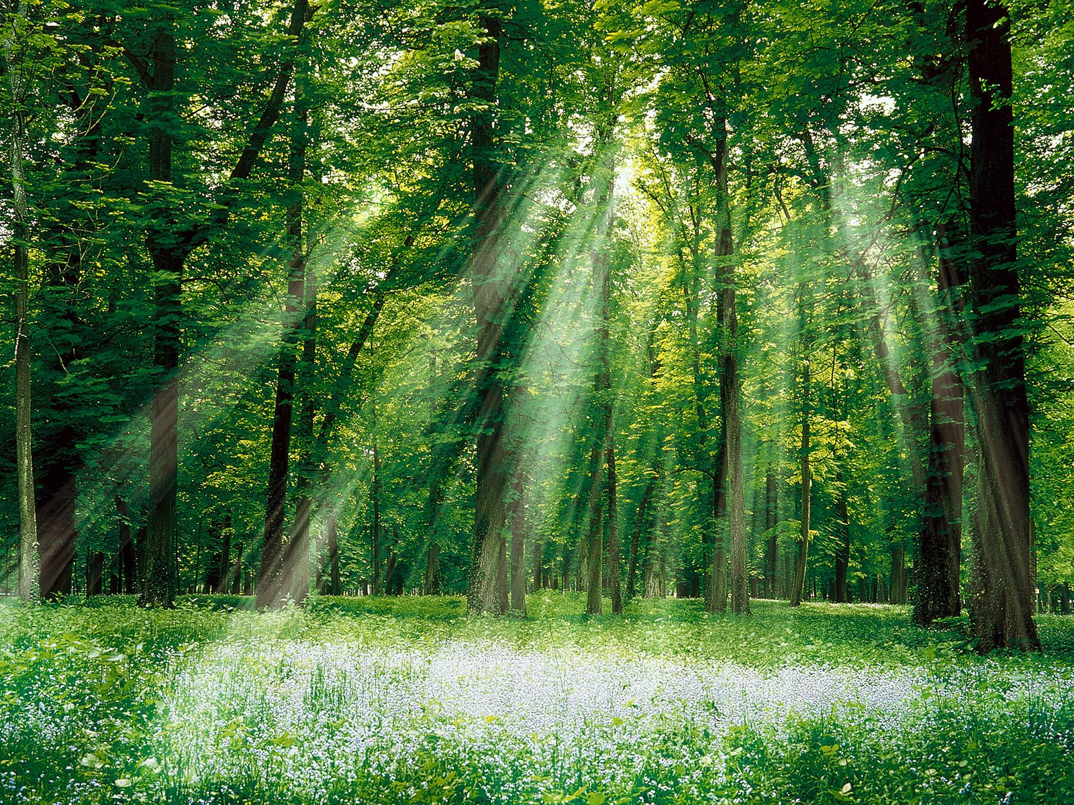
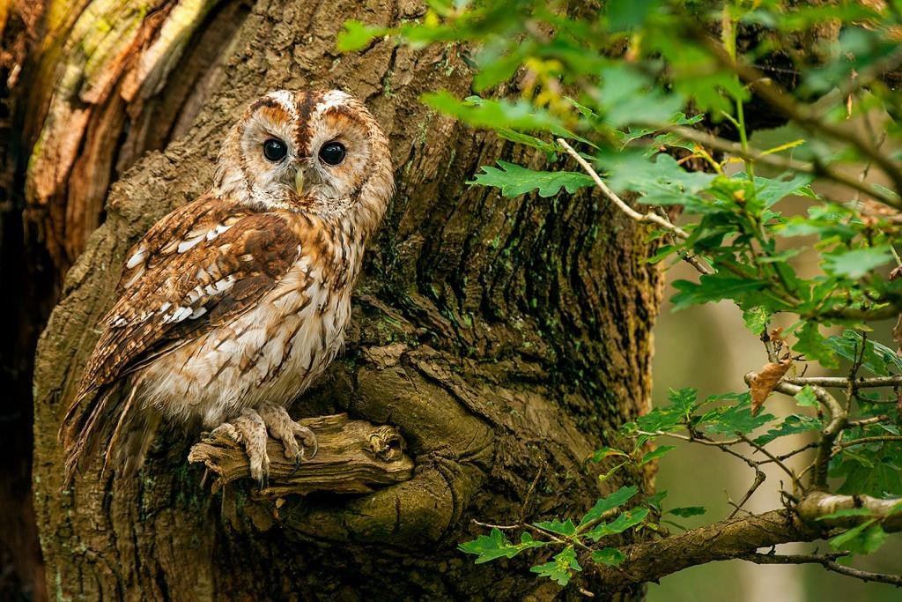
What are forests? And what types are there?
Forests are ecosystems that hold a large and dense amount of trees. They provide resources and shelter for many different organisms, such as rabbits, snakes, deer, hawks, owls, and countless more.
Forests also help maintain the quality of soil, air, and water, as well as contributing and maintaining our planet’s biogeochemical cycles.

Slide 3
What are forests? And what types are there?
Predominantly, there are three main types of forests found around the globe.
Tropical Rainforests- Humid and heavily precipitation based forests found near the equator, they hold poor-nutrient and acidic soil due to immense fauna and are rich in biodiversity.
Temperate Forests- Moderately-dense canopies that allow for light penetration, rich vegetation and at least 3-4 species of tree species per square kilometer, they also have fertile soil that was enriched with decaying litter.
Boreal Forests- Low temperature forests with thin, nutrient-poor soil, light rays are much less present in the this area and wildlife is quite limited due to colder temperatures.

Slide 4
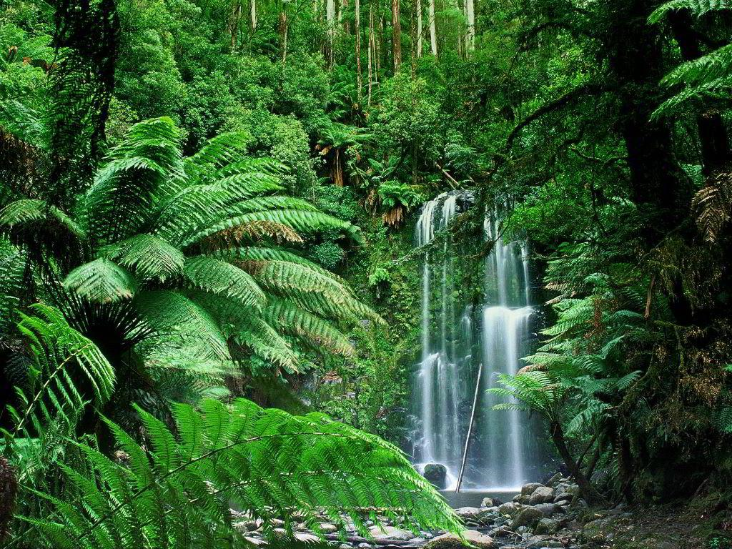
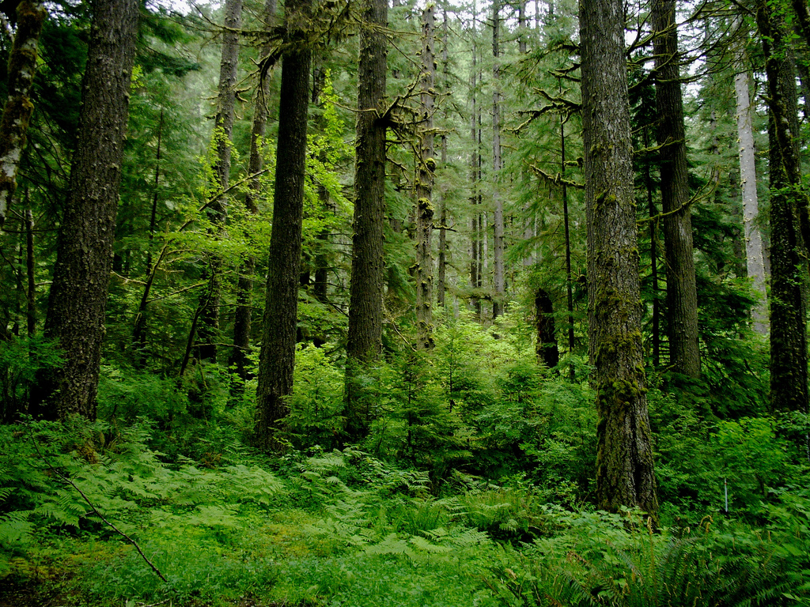
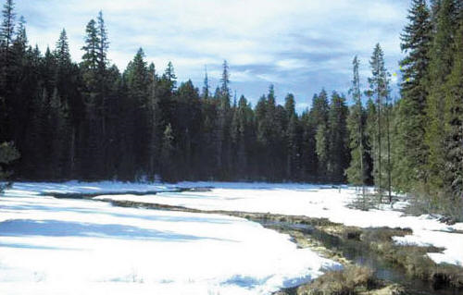
What are forests? And what types are there?

Slide 5
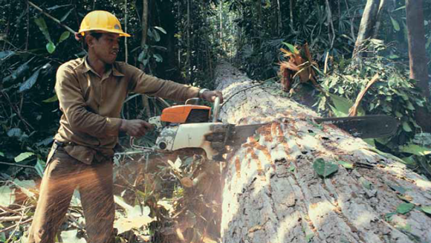
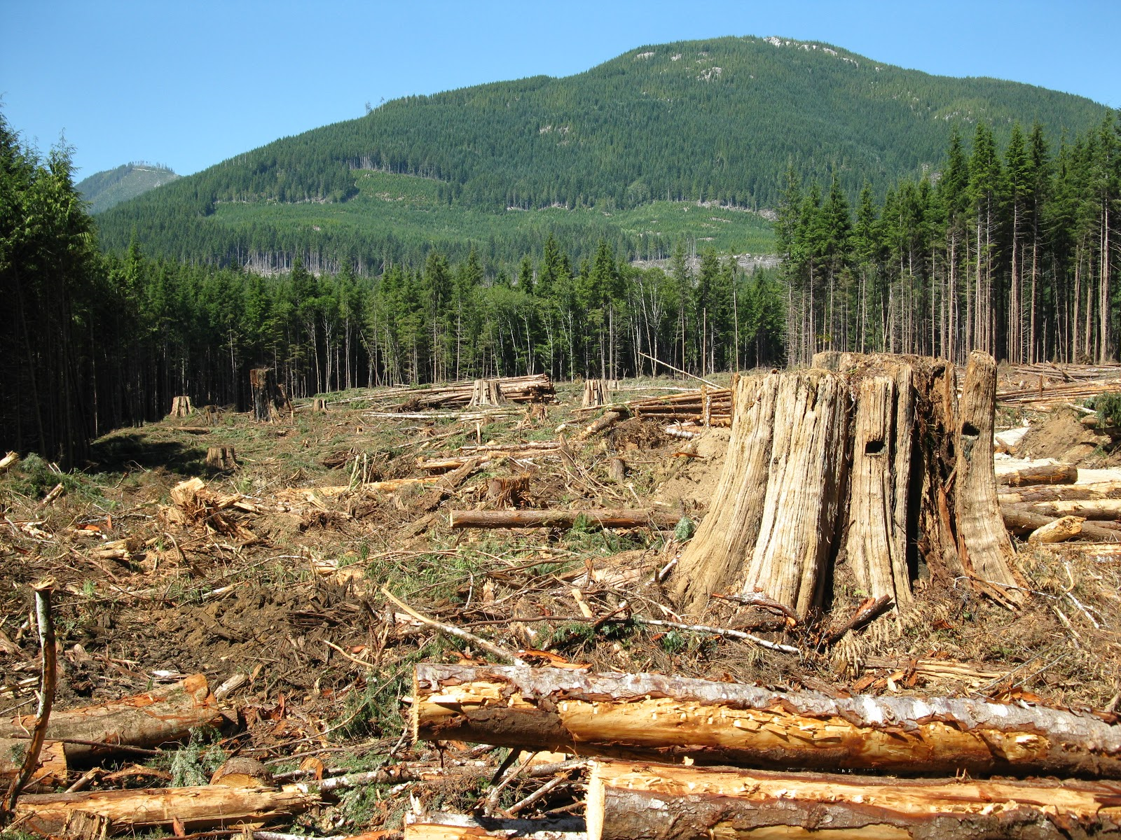
What is Deforestation? Why is it happening?
Deforestation is the clearing and loss of forests around the globe.
Many nations and industries cut down forests in order to increase land availability for housing and urbanization (which would lead to human population growth), to harvest timber and make commercial items such as paper, furniture, and homes. They are cut down for ingredients, most often for palm oil, extracted from palm trees. Finally, to create farms and cattle ranches.

Slide 6
What are the effects of deforestation?
Soil erosion is one major effect that takes place when trees are removed and not anchored to the ground, which would result in the soil being blown away or washed away. This would cause a future impact as soil erosion can lead to water acidification as different minerals and substances from the soil are eroded into major bodies of water, including the ocean.
Water cycle is affected as many trees are no longer available to hold H20, therefore many plants surrounding these deforested areas will instead rely heavily on it, water will also be more likely to become polluted since trees helped to lessen the pollution of water.
Without trees, there will be less natural processes to conduct photosynthesis and take in CO2 to create pure oxygen. Therefore the air quality will continue to worsen as there are less trees to provide clean air and more greenhouse gases will be present within the atmosphere.

Slide 7
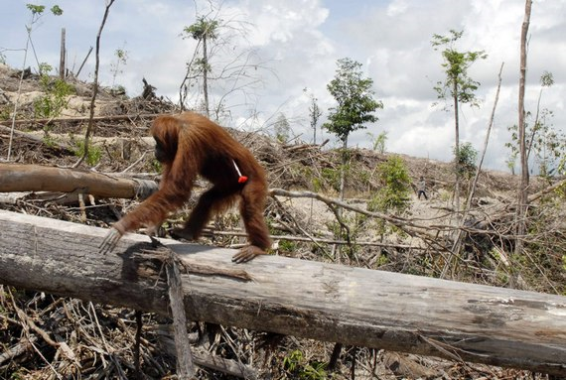
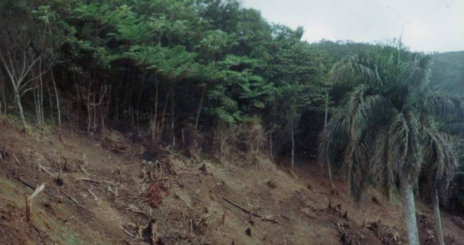
What are the effects of deforestation?
A loss of species will become heavily present in the process of deforestation since many trees and logs used as homes and habitats will be removed and destroyed, in effect this will cause many native species to migrate to other regions or they may just die off as resources are no longer available for them. This may even put several species of wildlife at risk of extinction.
Deforestation can even lead to disturbances of native people living in these forests (mostly the Amazon), these natives would face destruction of their homes and way of life, and may even destroy their cultures and have grave effects on their small yet fragile societies.

Slide 8
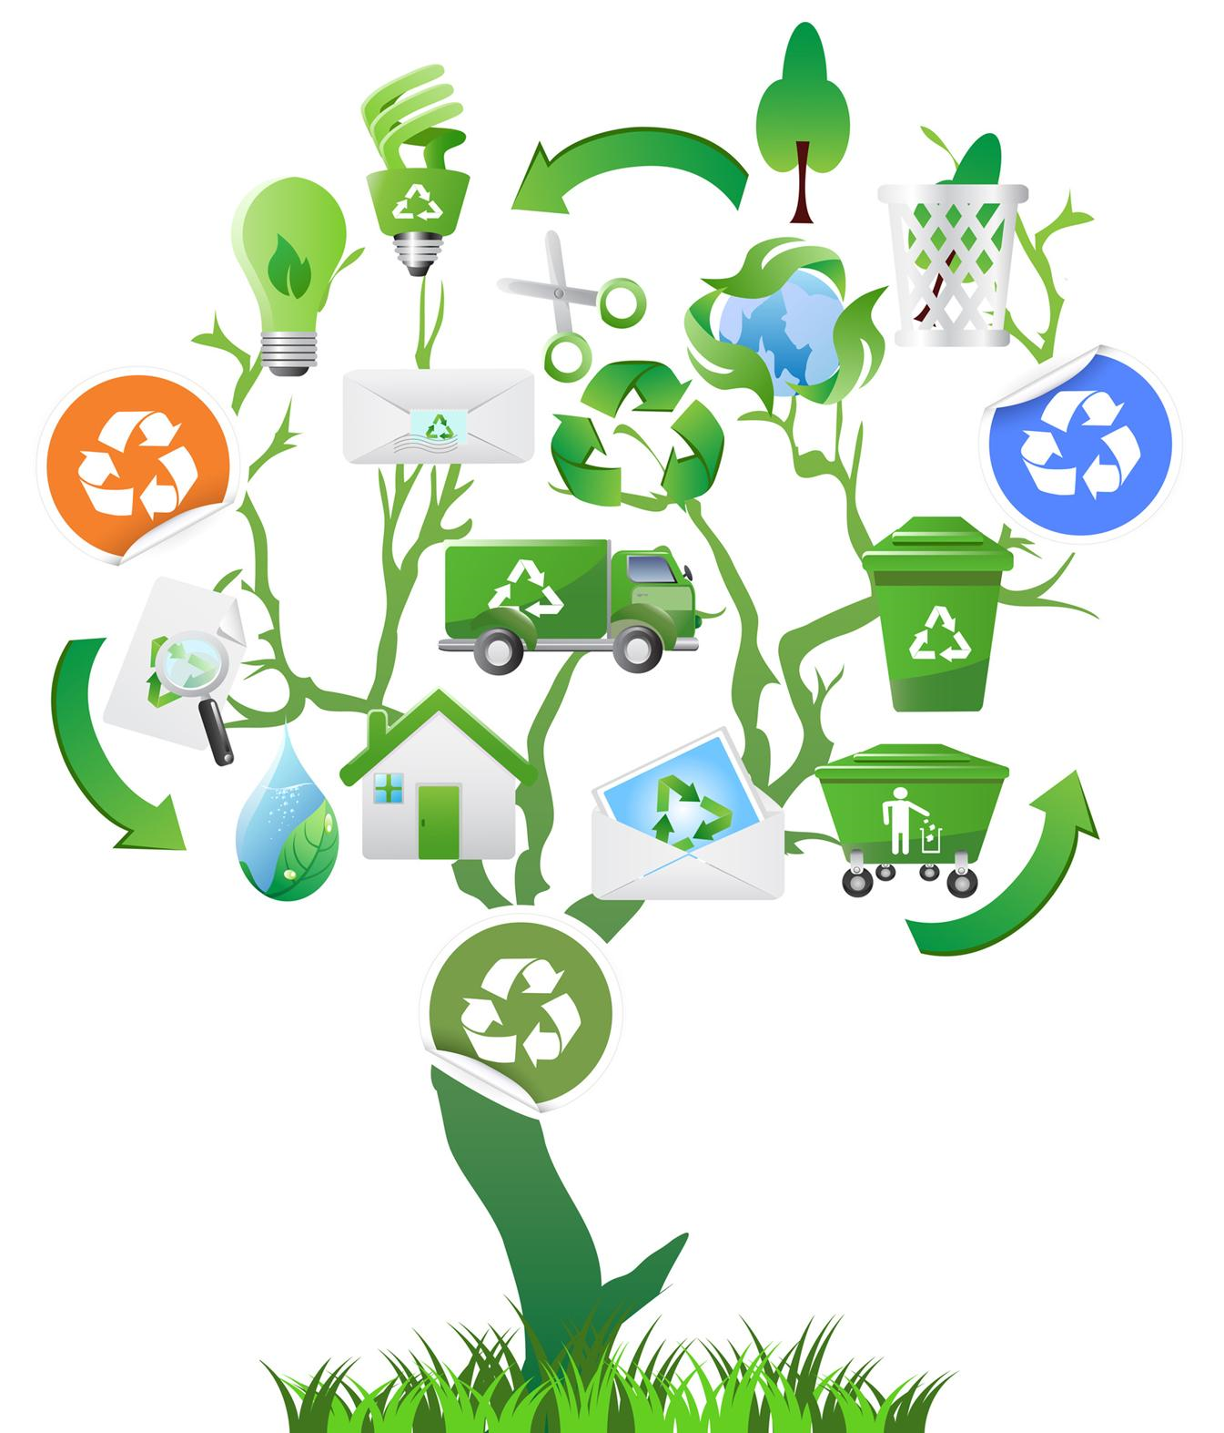
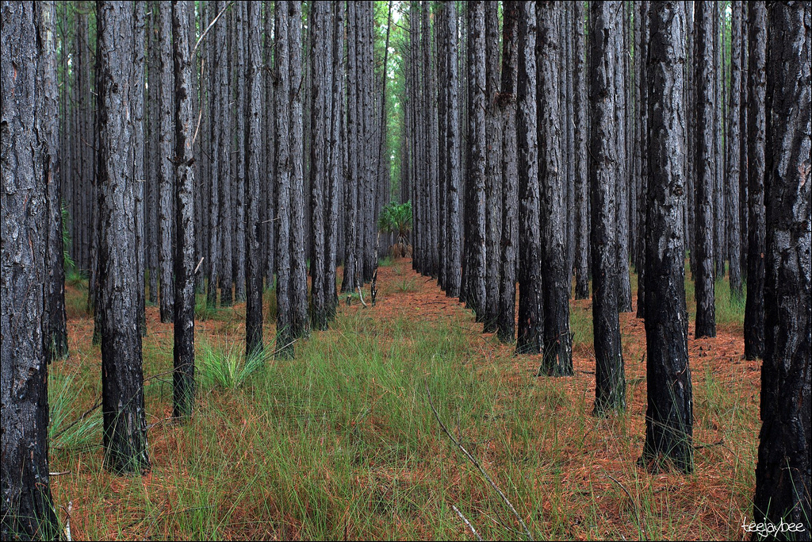
Solutions?
Despite deforestation continuing to happen across the globe there are excellent methods to addressing and fixing this issue that can be utilized to prevent and regulate the destruction and logging of forests.
One of the first solutions is to reuse, reduce, and recycling plastics, paper, aluminum, and wood to decrease the consumption and demand for more wood resources.
Sustainable forestry practices allow for the growth of timber in plantations, these can then be efficiently used and managed in order to provide consumption of materials without the need to cut down primary forests.

Slide 9
Solutions?
Laws and regulations have also been enacted to decrease and manage the destruction of forests, but illegal logging activities for timber and other resources such as rubber and palm oil continue to take place in developing countries.
Reforestation is used by many communities and governments to replant forests around fields and urban areas as a means of restoration for the environment.
Land-use planning benefits both society and the environment as urban areas are developed to be less sprawled and urban agricultures incorporated to manage consumer demands, therefore decrease deforestation and promoting housing.

Slide 10
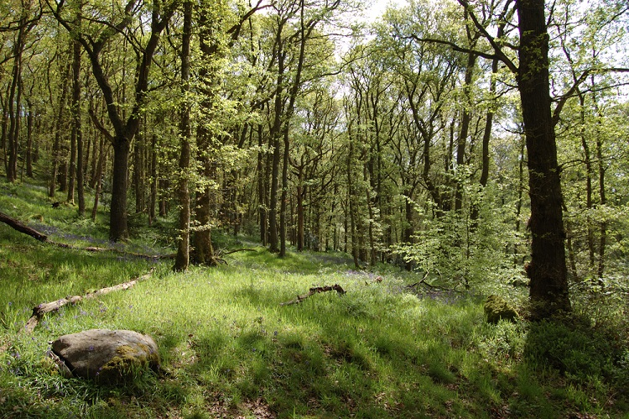
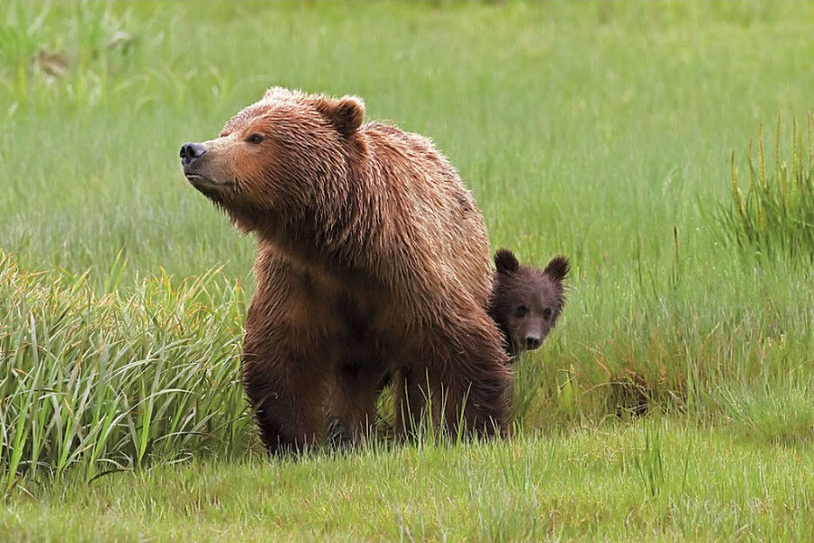
Epilogue
In general, forests are all delicate and fragile environments and ecosystems that should never be tampered with, these environmental regions provide us and every other species with clean air, food (such as fruits and hunting game), wood for homes and cooking, and can even provide spiritual enlightenment away from modernization.
Nevertheless, it is always important to understand that these amazing ecosystems need to be preserved and heavily regulated, because if industrial efforts continue to expand and human population growth continues to rise then in the future there will be no forest habitats or timber to supply our species with any resources and will leave catastrophic effects for us and every other species on the planet.

Slide 11
Works Cited
“How Does Deforestation Affect Animals?” Greentumble, 18 July 2018, greentumble.com/how-does-deforestation-affect-animals/.
Hayati. “Types of Forests in The World and Their Attractions and Tips to Visit.” Styles At Life, 12 June 2018, stylesatlife.com/articles/types-of-forests/.
Bradford, Alina. “Deforestation: Facts, Causes &amp; Effects.” LiveScience, Purch, 3 Apr. 2018, www.livescience.com/27692-deforestation.html.
“DEFORESTATION CAUSES, IMPACT, EFFECTS, FACTS, DEFINITION.” LOSS OF BIODIVERSITY CAUSES, IMPACT, EFFECTS, FACTS, DEFINITION, www.saveearth.info/deforestation/.
“Effects of Deforestation | The Pachamama Alliance.” Sources and Solutions | Pachamama Alliance, www.pachamama.org/effects-of-deforestation.
“8 Fantastic Solutions to Deforestation.” Earth Eclipse, 11 Sept. 2017, www.eartheclipse.com/environment/fantastic-solutions-to-deforestation.html.

